Slide 1
Gluscope
By Ashanti Boone, Bruce Metoyer, Devine Chinemere, Lloyd Bolodeoku

Slide 2
Problem Statement
Today, many people have diabetes or are pre-diabetic and don’t even know it. What if a solution would respond to such health issues by scanning blood sugar levels and having nurses and parents access the information? Children, especially, eat a lot of different foods and don’t necessarily always take care of themselves. Pointing out high or low blood sugar levels allows early issues to be dealt with in kids but could also be noticed in adults.

Slide 3
Background Information
Kids now have no idea of their family’s history or the amount of sugar they have concentrated in their blood. Not only kids but people all around the world are walking around pre-diabetic or with diabetes. We were motivated to design a device that would constantly scan the blood sugar amount while providing information to nurses and parents to monitor their children.

Slide 4
What is GluScope
GluScope is an app designed to assist school nurses, parents, and diabetic students in grades K-12 monitor blood sugar levels. The app has a smartwatch called GluScope, which the student wears. It then provides real-time data and notifications to school nurses based on the alert level.

Slide 5
Benefits of GluScope
The benefits of GluScope include:
Being able to detect high or low blood concentration levels in children
Immediate access to resources when the user’s blood concentration levels are dangerous
A constant monitor system that regularly scans for high sugar levels in blood
Can diagnose kids at a younger age for diabetes

Slide 6
Application Features
1. Blood Sugar Tracking:
Students wear the GloScope watch, which monitors blood sugar levels.
The app receives data from our backend server and displays alerts informing parents/school nurses based on severity.
2. Alerts and Notifications:
Based on blood sugar readings, the app triggers different alerts:
High Blood Sugar: Notifies the school nurse immediately.
Moderately Low Blood Sugar: Provides suggestions to raise blood sugar levels.
Very Low Blood Sugar: Alerts a doctor for urgent intervention.
3. Recommendations:
Gives children recommendations on how they should proceed with the blood sugar is at a certain level
If High Blood Sugar:
Tell the child to hydrate, avoid sugary foods, and administer insulin to the child.
If Moderately Low Blood Sugar:
Give the child a small snack, such as Fruit juice, and monitor the child and recheck their blood sugar after 15 - 20 minutes.
Very Low Blood Sugar:
CALL FOR MEDICAL SERVICES.
Administer insulin to the child (if prescribed/available).
4. User Profiles:
Nurses can view a list of students who own and are wearing devices.
The information displayed in the list of children includes student information, emergency contacts, and medical history.

Slide 7
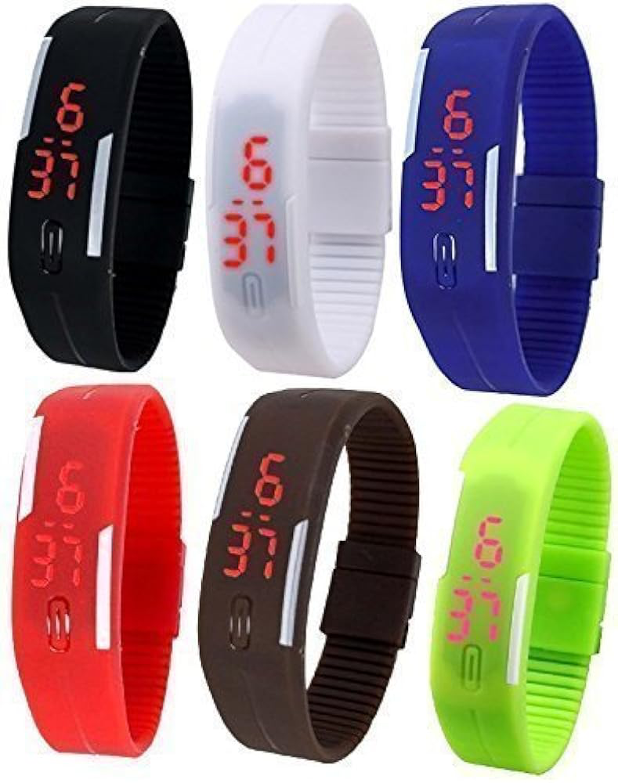
Prototype Description
We plan to implement our prototype as a sleek, affordable watch band with various colors.
Our prototype is sleek in shape due to the primary audience being kids.
We chose rubber straps that are recyclable and comfortable for use.
The prototype will serve its purpose as a regular watch, while the GluScope app will alert them when their sugar blood levels are too high or low.

Slide 8
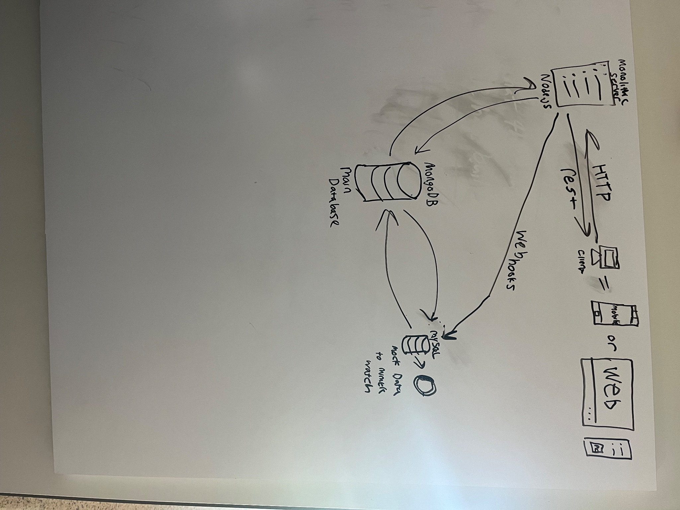
Data Analysis

Slide 9
Safety and Privacy
The device will track students when they are on school grounds so that nurses can be alerted when and where the child’s blood sugar levels are too high.
The app will allow parents to decide whether they want their child to be tracked at all times.
There is also encryption data for login data for nurses and parents when signing up for the app.
For location tracking, we are utilized geofencing technology

Slide 10
Future Considerations
Integration of dashboards for graphical data visualization of current trends.
Exploration of AI, ML, and NLP for predictive analysis of user health activity trends.
Development of geofencing zones to enhance safety and privacy measures.
Implementation of real-time geographic mapping for tracking individuals.
Comprehensive infrastructure architecture to ensure scalability, reliability, and security.

Slide 11
Any Questions, comments, concerns?
Thank You!

